Slide 1
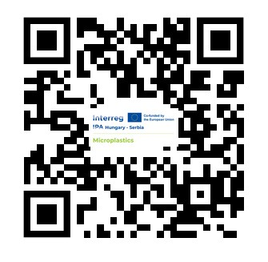
QR for the Conference Abstract Book
18. Septembar 2025. Novi Sad

Slide 2




Project
The Interreg VI-A IPA Hungary-Serbia Programme is implemented within the 2021-2027 European Union financial framework, under the Instrument for Pre-accession Assistance (IPA).
The Programme funds and supports co-operation projects of organizations located in the Programme-eligible area - Hungarian counties Csongrád-Csanád and Bács-Kiskun, and Serbian territories: West Bačka, North Bačka, South Bačka, North Banat, Central Banat, South Banat and Srem.
The Programme helps the development of a stable and co-operating region and the overall quality of life in the border region; enables economic collaboration of organizations from the two countries, nurtures the common identity, and cultural and historical heritage of the border region; contributes to its environmental sustainability and safety.
Project ID: HUSRB/23R/12/089
Project acronym: MICROPLASTICS
Project title: MInimizing CROssborder water contamination of microPLASTICS
Priority: A greener region
Objective: Biodiversity and reduce pollution
Budget of the project: 1,372,328.40 EUR
Maximum EU contribution: 1,166,479.14 EUR
Project starting data: 01.07.2024.
Project end date: 30.06.2026.
Role | Official name of the organization (in original language) | Country | NUTS III region or equivalent | NUTS V - settlement(s)
LA | Institut za javno zdravlje Vojvodine | Serbia | Južnobački upravni okrug | Novi Sad
A1 | Zavod za javno zdravlje Sombor | Serbia | Zapadnobački upravni okrug | Sombor
A2 | Nemzeti Közszolgálati Egyetem University of Public Service | Hungary | Budapest | Budapest
A3 | Fond "Evropski poslovi i razvoj" Autonomne pokrajine Vojvodine | Serbia | Južnobački upravni okrug | Novi Sad

Slide 3
Overall Objective
Project overall objective is to enhance environmental protection and reduce pollution by identifying sources and reducing microplastic pollution in the water ecosystem within the crossborder area Bačka/Bács-Kiskun.
This is going to be achieved through sampling and identification of pollutants as well as modeling and developing measures and tools to reduce the microplastics pollution in the water ecosystem while at the same time increasing public awareness on the problem and solutions developed.

Slide 4
Project Summary
The MICROPLASTICS project focuses on preserving nature in the cross border area by identifying the sources of pollution and reducing the level of the water ecosystem pollution by microplastics.
Specific set of outcomes are:
1. Determining the extent and amount of microplastics pollution within the water ecosystems (river, canals and wastewater treatment facilities) and identifying the sources of pollution within the CBC region, including protected locations Gornje Podunavlje, Begečka jama, nature park Gemenc, Riha oxbow lake.
2. Establishing the regional system for measuring and monitoring of microplastics and developing the recommendations for increasing the efficiency of measures to protect nature and the environment.
3. Designing the pilot action project and testing filtration solution for wastewater treatment facilities and identifying the waste water treatment facilities in the region for potential replication of project outcomes in the future.
4. Engaging school children, public officials, experts and the general public in educational and awareness raising activities for reducing water and soil pollution and deterioration of natural habitats.

Slide 5
Target groups
Public health experts working within the partner organisation and within the sector (20 people),
Partner organizations participating in the project (4 organization),
(3) School children - participating in the educational activities (200 pupils),
(4) High school Students - participating in the educational activities (150 students),
(5) Water management, public health, and local authorities representatives - participating in the educational activities (20 people),
(6) General population - (200 people),
(7) NGO active in nature preservation (4 NGO).

Slide 6

Indicators
Name of indicator | Unit | Target value | Sources of validation
Public events across borders jointly organised | event | 2,00 | Report on cross border conference and study tour
Pilot actions developed jointly and implemented in projects | pilot actions | 1,00 | Report on the implementation of the pilot action for two facilities together with mapped Wastewater plant treatment facilities
Organisations cooperating across borders | organizations | 4,00 | Six Minutes from Joint coordination meetings. Six Project reports. Joint Communication plan
Organisations cooperating across borders after project completion | organizations | 4,00 | Memorandum of understanding between partner organisations signed by all project partners.
Number of actions contributing to the elimination of pollution sources | action | 1,00 | Report - after the implementation of education on the Programme platform. Developed protocols - electronic document
Number of educated persons on environmental and nature protection topics | person | 300,0 | Report from workshop in elementary schools Report from high school workshop Report from roundtable Developed ICT solution

Slide 7
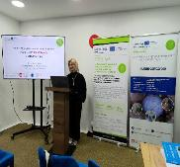
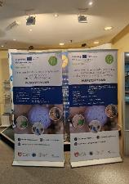
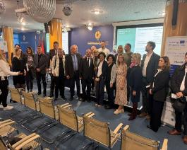
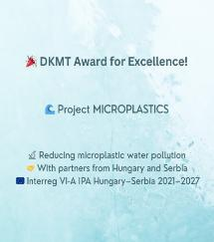
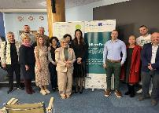





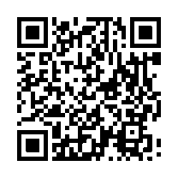
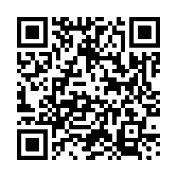
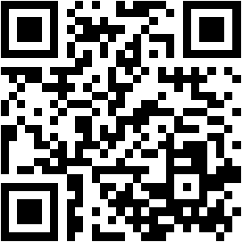
Activities
Activity | Description of activity
0.1 Project management | All partners
0.2 Communication | All partners - opening conference, ecological promotion material, roll ups, visibility, closing conference, film, media, platform
Synergie:
Microdrink project
Conference “Microplastics for Breakfast," April 10, 2025, SUPERLAB Institute,Vrčin. https://www.microplasticsforbreakfast.com/
Participation in joint newslater – Microdrink activity
Participation in Conference „Water 2025“, Kopaonik, Serbia
Opening conference, Novi Sad 17.10.2025.
Members of DKMT Euroregion Award for Excellence for CBC cooperation in 2024
Ecological promotion material
Facebook:
Instagram:
Program website:

Slide 8
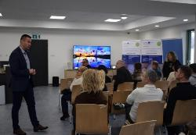
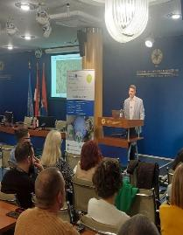
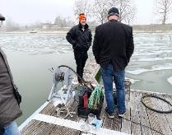
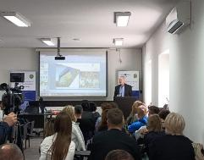
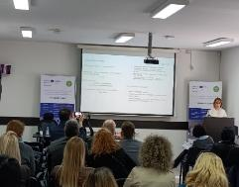
Activities
Activity | Description of activity
1.1 Education of Public Experts | 1st education of public experts – Novi Sad, 18.10.2024. 2nd education of public experts – Sombor, 10.03.2025. 3rd education of public experts – Baja, 17.07.2025
1.2 Procurement of equipment for sampling and detecting
Equipment for sampling:
Pump method for water
Manta net
Grab sampler for sediment
Boat
Equipment for analysing:
FTIR spectroscopy
Filters
Evaporation systems
Chemicals and consumables
Basic laboratory equipment and dishes
IT equipment
Equipment for pilot project:
Membrane vacuum filtration system with vacuum pump

Slide 9
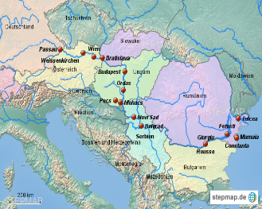

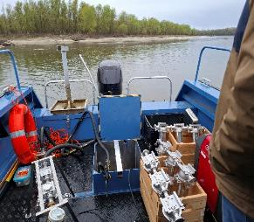
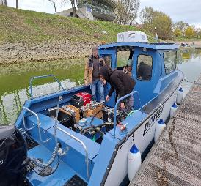


Activities
Activity | Description of activity
1.3 Sample collection | Water: 117 samples River sediment: 10 samples (HU) Planned sample points open surface water (34 samples: 16HU/18SRB) - upstream and downstream to discharge wastewater: Baja, Mohacs, Bezdan, Sombor, Bačka Palanka, Novi Sad; Canals (38 samples: 28HU/10SRB): Ferenc-Chanel, Baja Bezdan canal, Kígyós Canal System In nature parks (22 samples: 12HU/10SRB): nature park Gemenc, Riha oxbow lake, Gornje podunavlje, Begečka jama Wastewater (23 samples: 4HU/19SRB): Baja, Sombor (pilot project), Novi Sad
1.4 Validation of methods | Analyses and validation of methods are in progress.
1.5 Protocol development | In progress
Sombor
Sombor
Baja
Baja

Slide 10
Activities
Activity | Description of activity
2.1 Development of filtration method - Pilot | Researches from HU are developing filtration method for two partners – Baja and Sombor (two wastewater facilities in CBC region) – in progress
2.2 Procurement of the equipment for filtration of microplastics
2.3 Testing of a developed solution | In progress
2.4 Mapping of existing wastewater facilities | In progress
3.1 Educational activities in elementary schools | In 6 schools (3 HU/3 SRB), 40 pupils/education – started in HU
3.2 Educational activities in high schools | In 6 schools (3 HU/3 SRB), 25 students/education
3.3 Education of water management, LSG, population, NGO | 2 round tables (1 HU/1 SRB), 30 people/ education
3.4 Cross border conference, study tour | Conference – 18.09.2025., Novi Sad
3.5 Development of software solution | WEB platform – in progress

Slide 11
In the name of the entire Team of MICROPLASTICS Project
Institut za javno zdravlje Vojvodine, SRB
Zavod za javno zdravlje Sombor, SRB
Nemzeti Kozszolgaloti Egyetem (University of Public Service), HU
Fond “Evropski poslovi i razvoj” Autonomne pokrajine Vojvodine, SRB
Thank you for attention!
This document has been produced with the financial assistance of the European Union through the Interreg VI-A IPA Hungary-Serbia programme. The content of the document is the sole responsibility of Public Health Institute of Vojvodina and can under no circumstances be regarded as reflecting the position of the European Union and/or the Managing Authority of the Programme.

